Slide 1

Taking Off
Json (Jason), james, michelle, and patrick

Slide 2
Searching for Data
https://transtats.bts.gov/ONTIME/Index.aspx

Slide 3
The Data
Multiple CSV files
Some files had over 1 million rows of data
Reduced to 11 Aiports
Reduced to 5 Airlines

Slide 4
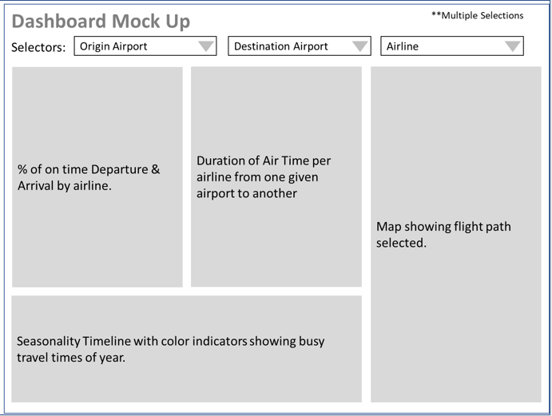
The Inspiration

Slide 5
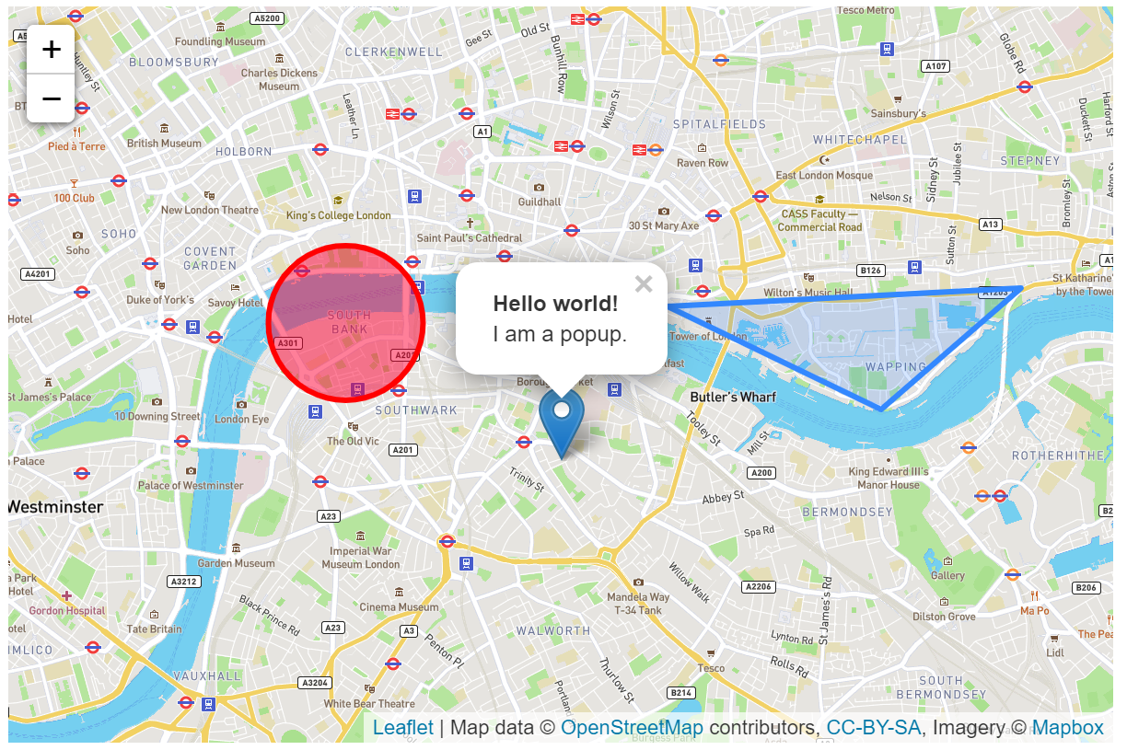
Using – Leaflet.js
https://leafletjs.com/examples/quick-start/

Slide 6
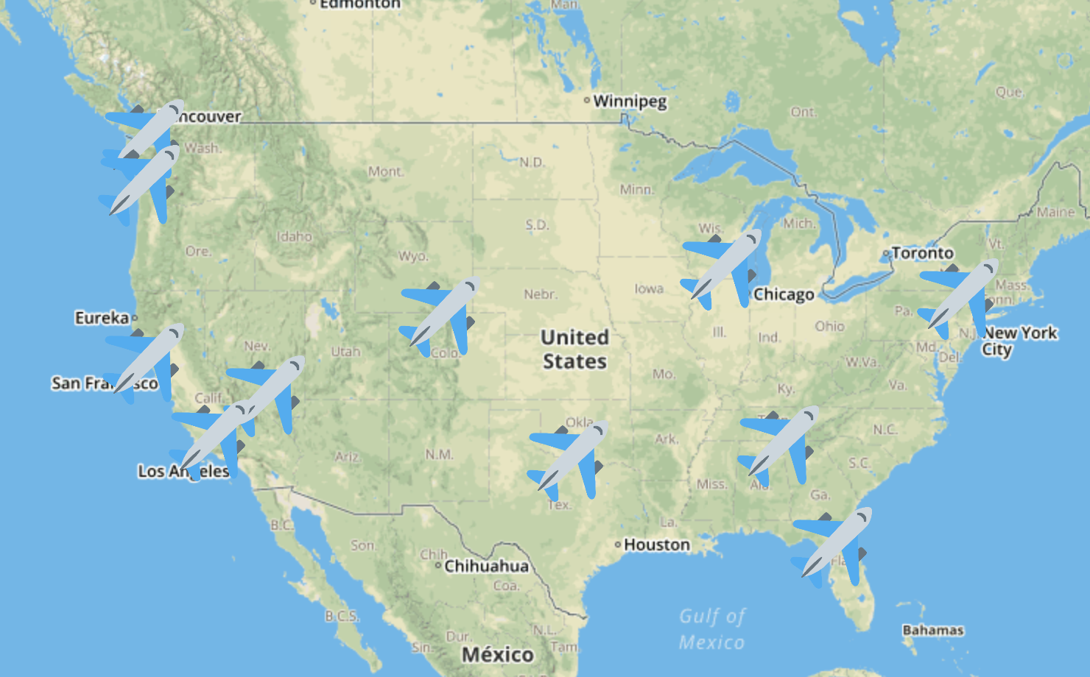
Our Idea - Leaflet.js
GOAL: Visualize 10 busiest airports
Use airplane as marker
Hover to show abbreviated airport name
Mouse click to show Popup:
Full airport name
City
State (abbreviation)
Population

Slide 7
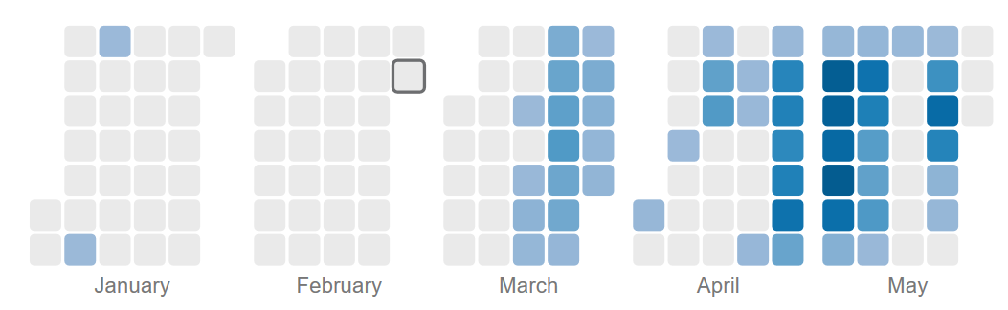
Using – Cal Heat map js module
https://leafletjs.com/examples/quick-start/

Slide 8
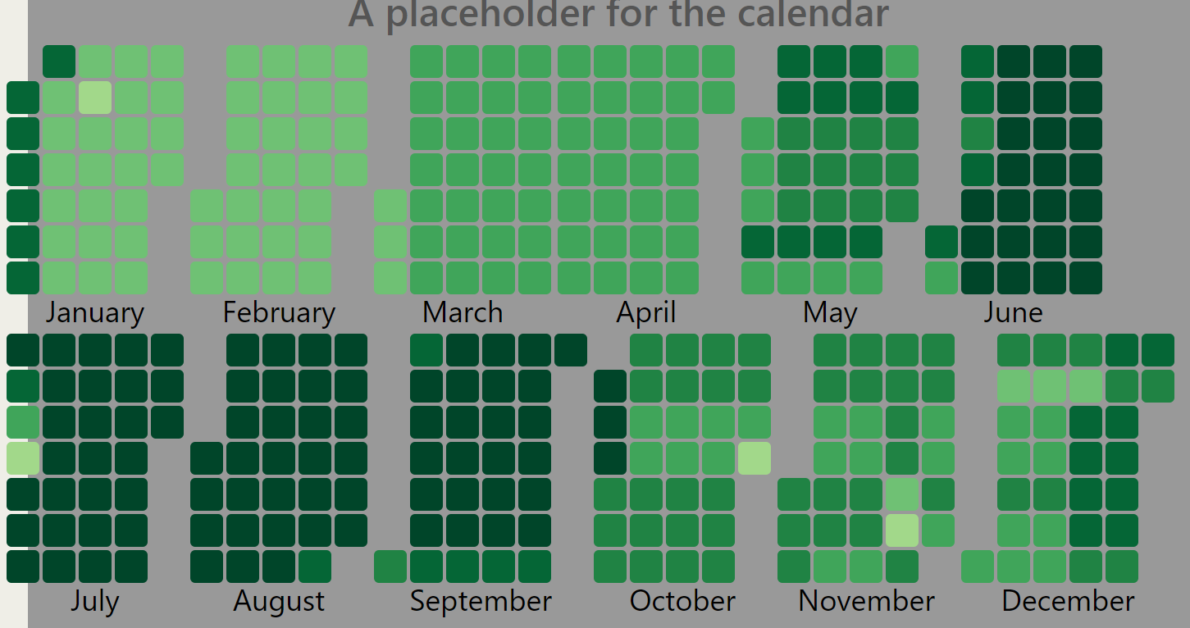
Our Idea – Cal heatmap
Vertical Calendar Heatmap – Shows delay data from data
Hover over to show date and avg
Use selector function to filter delayed data per Airline
Each shade to be scaled per range of relayed time
https://bl.ocks.org/danbjoseph/13d9365450c27ed3bf5a568721296dcc

Slide 9
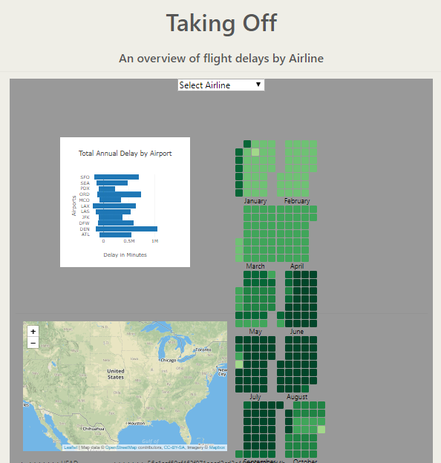
The Project Outcome

Slide 10
Challenges We Ran Into
Data Load:
2.4 million rows of data
217MB size
494K rows of data
JSON file too big
MongoDB
Calendar Heat Map

Slide 11
What We Learned
Understanding someone else’s code doesn’t make it easier
Project and Time management
Shifting through project ideas

Slide 12
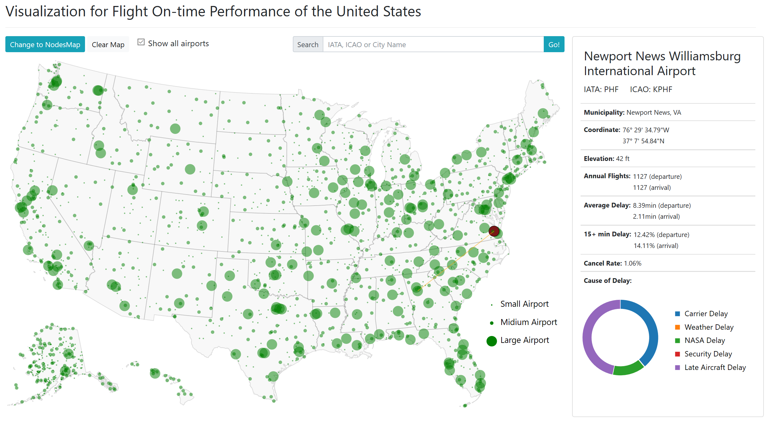
More Time Would Give us…

